Slide 1
Viva la revolution!

Slide 2


Slide 3
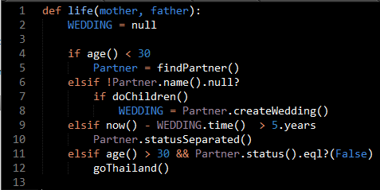

Slide 4
Retrospective
- What we did well?
- What we didn't do so well?
- What should we try?
- Thanks to someone?

Slide 5
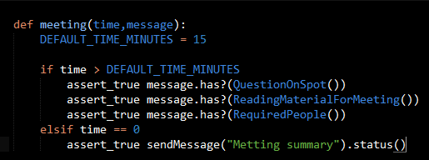
Introduce good meeting practices
Why?
have more free time, more people could attend
Proposal:

Slide 6
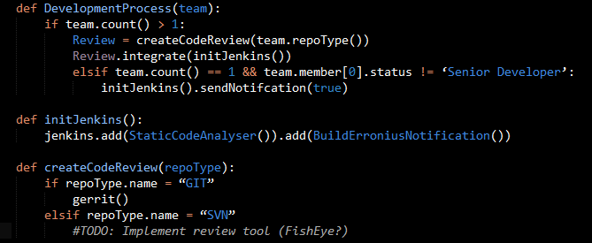
Continuous feedback to people
Why?
Senior Dev are all too busy with their stuff. Need to learn faster
Proposal:

